Slide 1
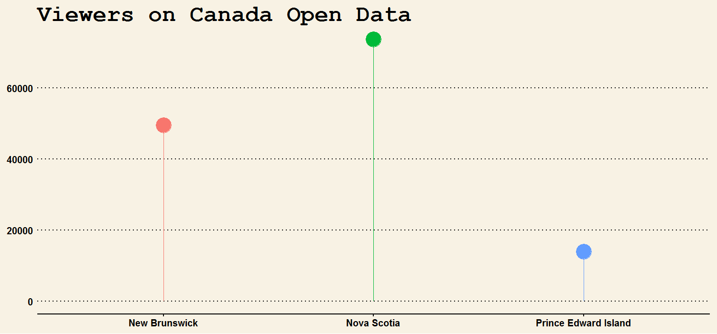
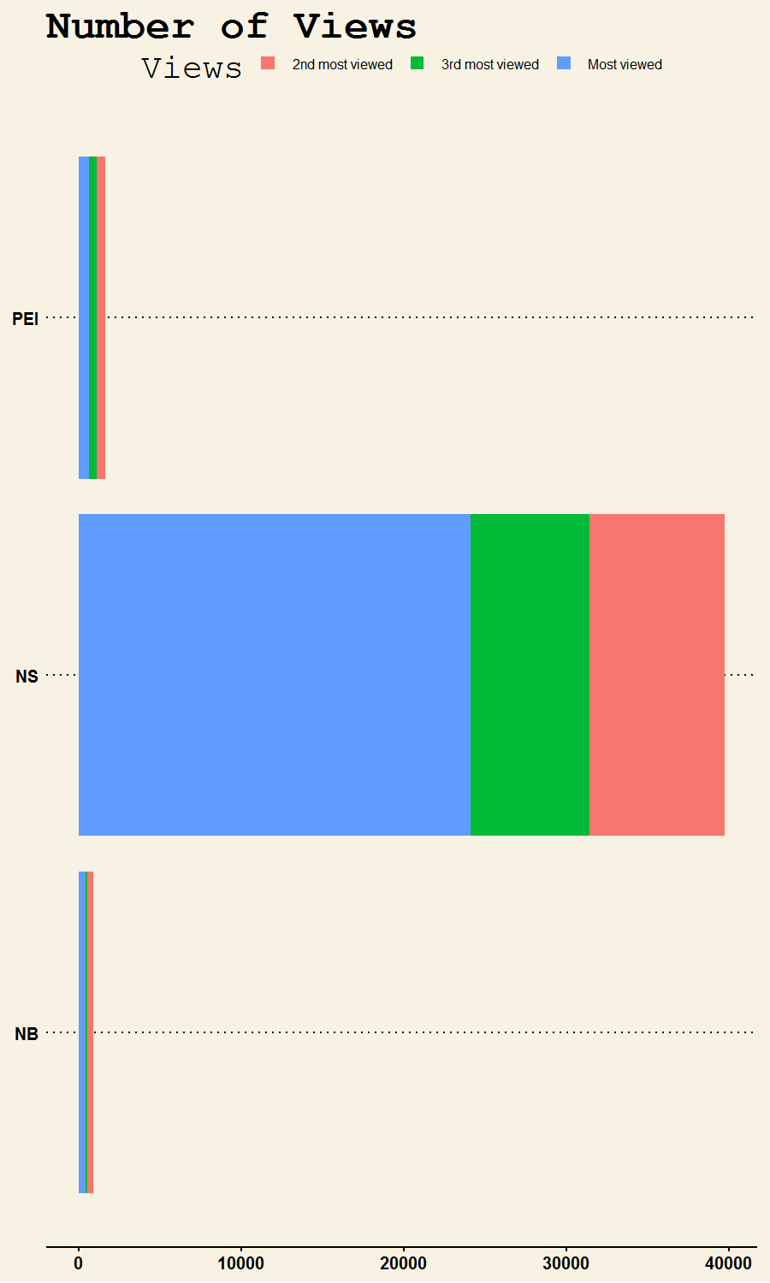
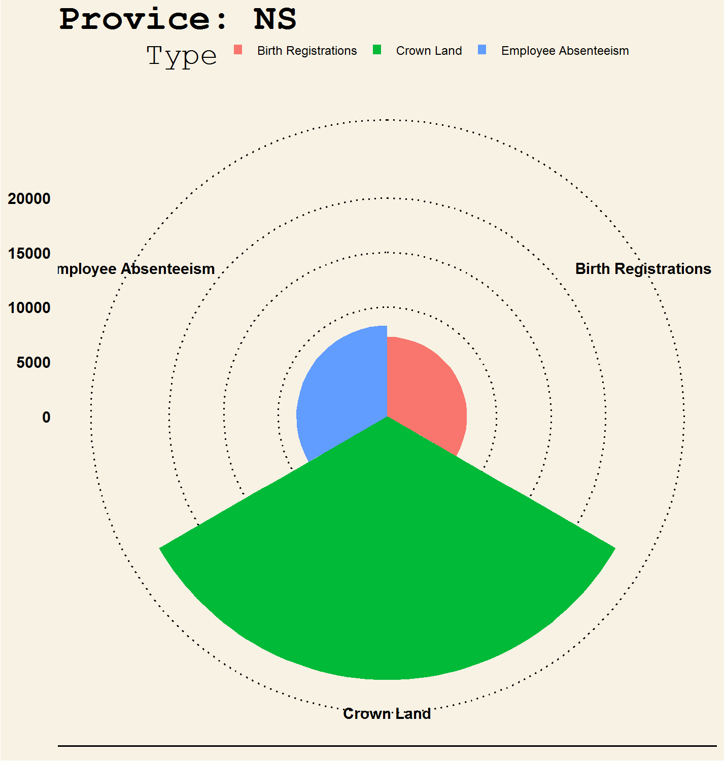
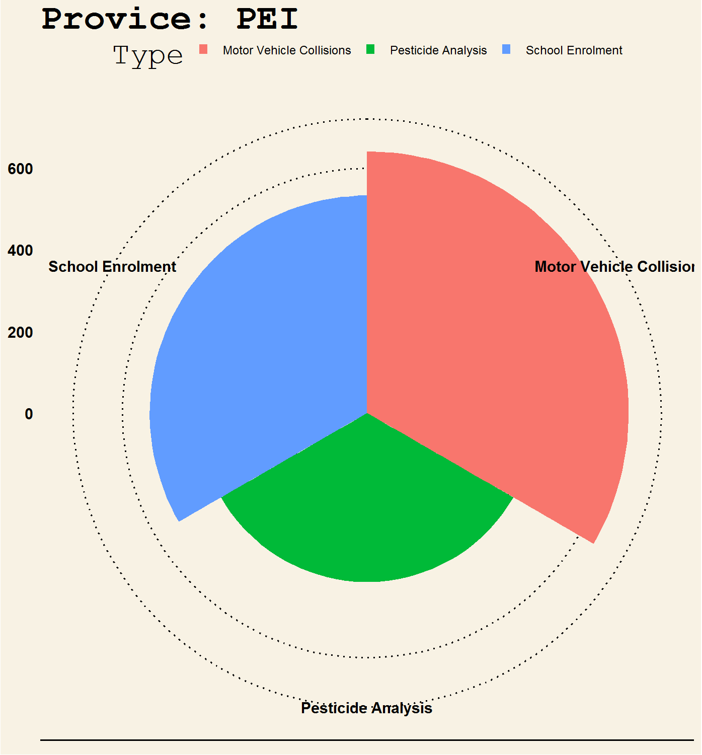
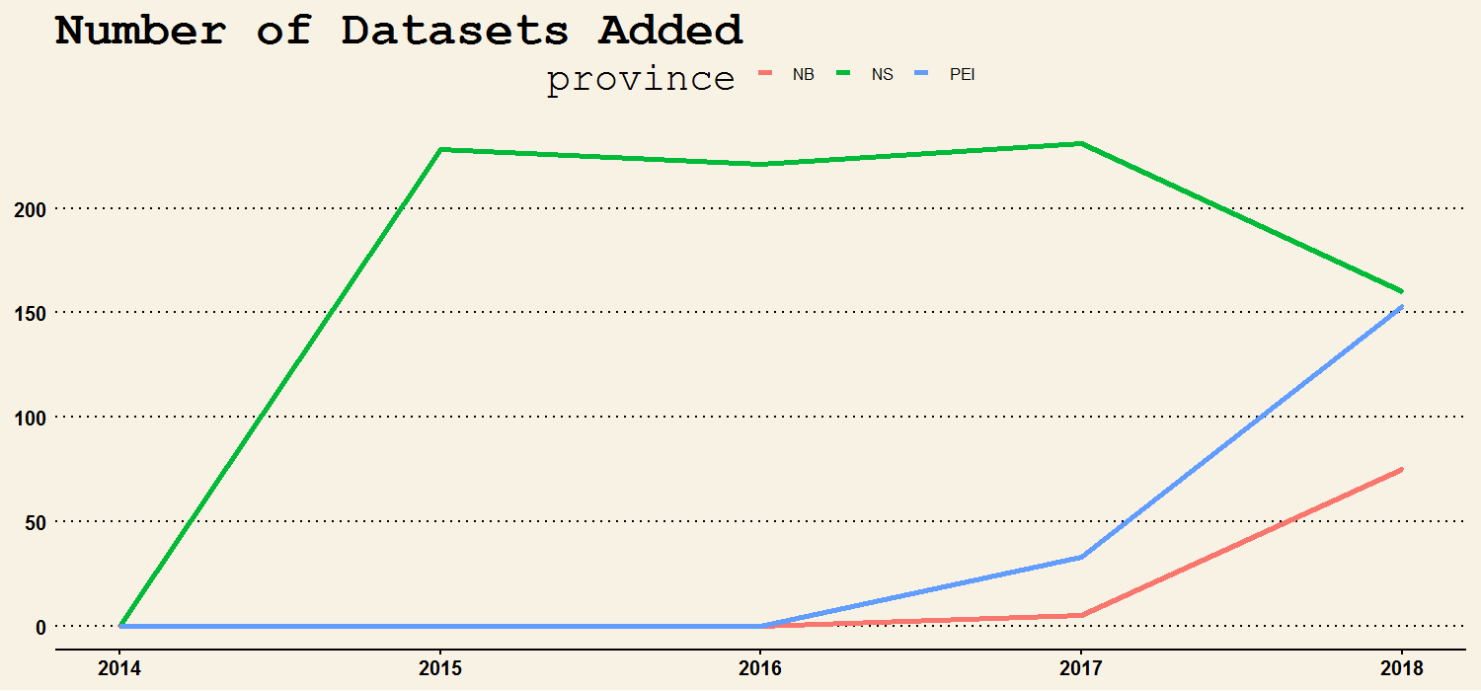
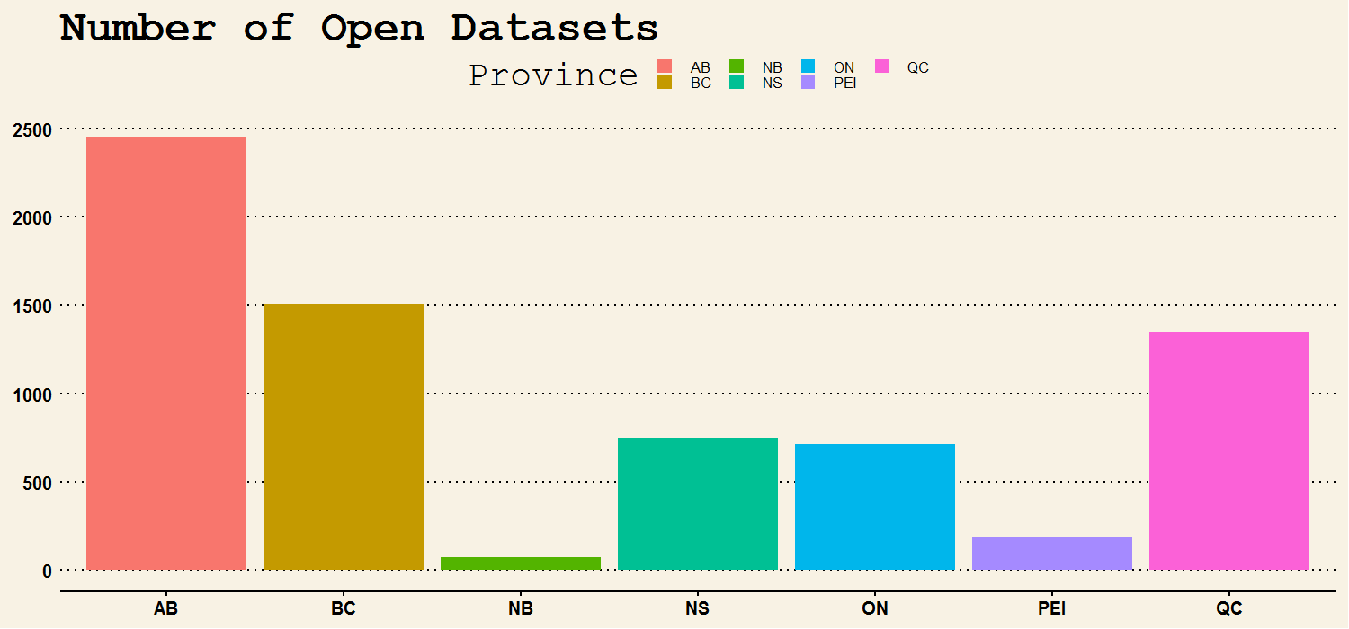
New Brunswick Open Data Checkup
Researchers, app developers, students and companies are all hungry for data. Lots of good data in a region attracts talent from everywhere and benefits our whole society. So, let us peek at what open data looks like in NB now compared to our neighbors!
New Brunswickers want open data
But open Data in NB is not very engaging
49,483
73,692
5x PEI’s population but half the views
PEI
Open Canada has the data I want
13,933
NS
80% NS’s population but less than 5% views
Top 3 most popular
New Brunswick
Nova Scotia
Prince Edward Island
NB
What data engages other provinces?
NS
PEI
Crown land is interesting
So is pesticide data
What insights are living inside pesticide data?
New Brunswick is adding more datasets each year
NS
NS had a head start!
Over 70 datasets added so far in 2018!
PEI
NB
But there is still a long way to go
Engage New Brunswickers with more and better quality data. Let the public vote on the data they crave to take deeper dives and discover meaningful insights.
Need
More
Data
NB
Note: Data compiled as of November 2018 from the Open Data portals of each province and Open Canada at https://open.canada.ca/en
New Brunswick data based on GNB Open Data portals (https://gnb.socrata.com/)
Produced by Abracadata

